Slide 1



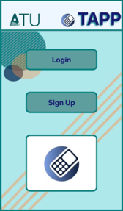

TAPP
(Transact-App)
Crypto Payment System
Final Year Project
Elise Santella

Slide 2

DESCRIPTION
A Crypto Payment System which provides the ability to transfer funds using two version of the app: Merchant and Customer
Why:
De-centralising , fast processing, secure
Learning new skills i.e. security features, app development, token creation

Slide 3
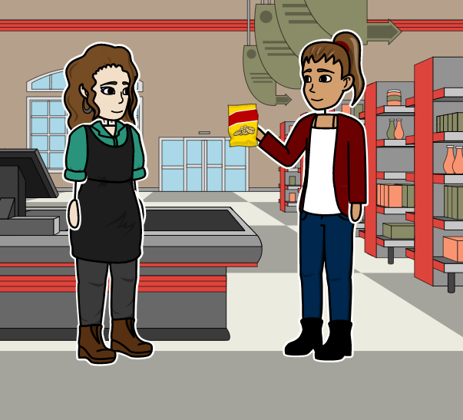
STORY BOARD

Slide 4
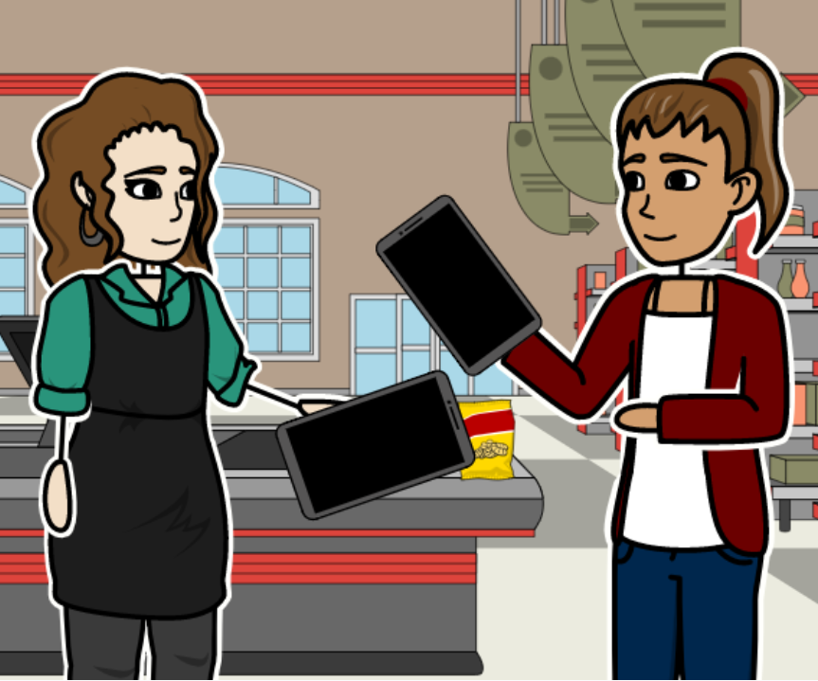
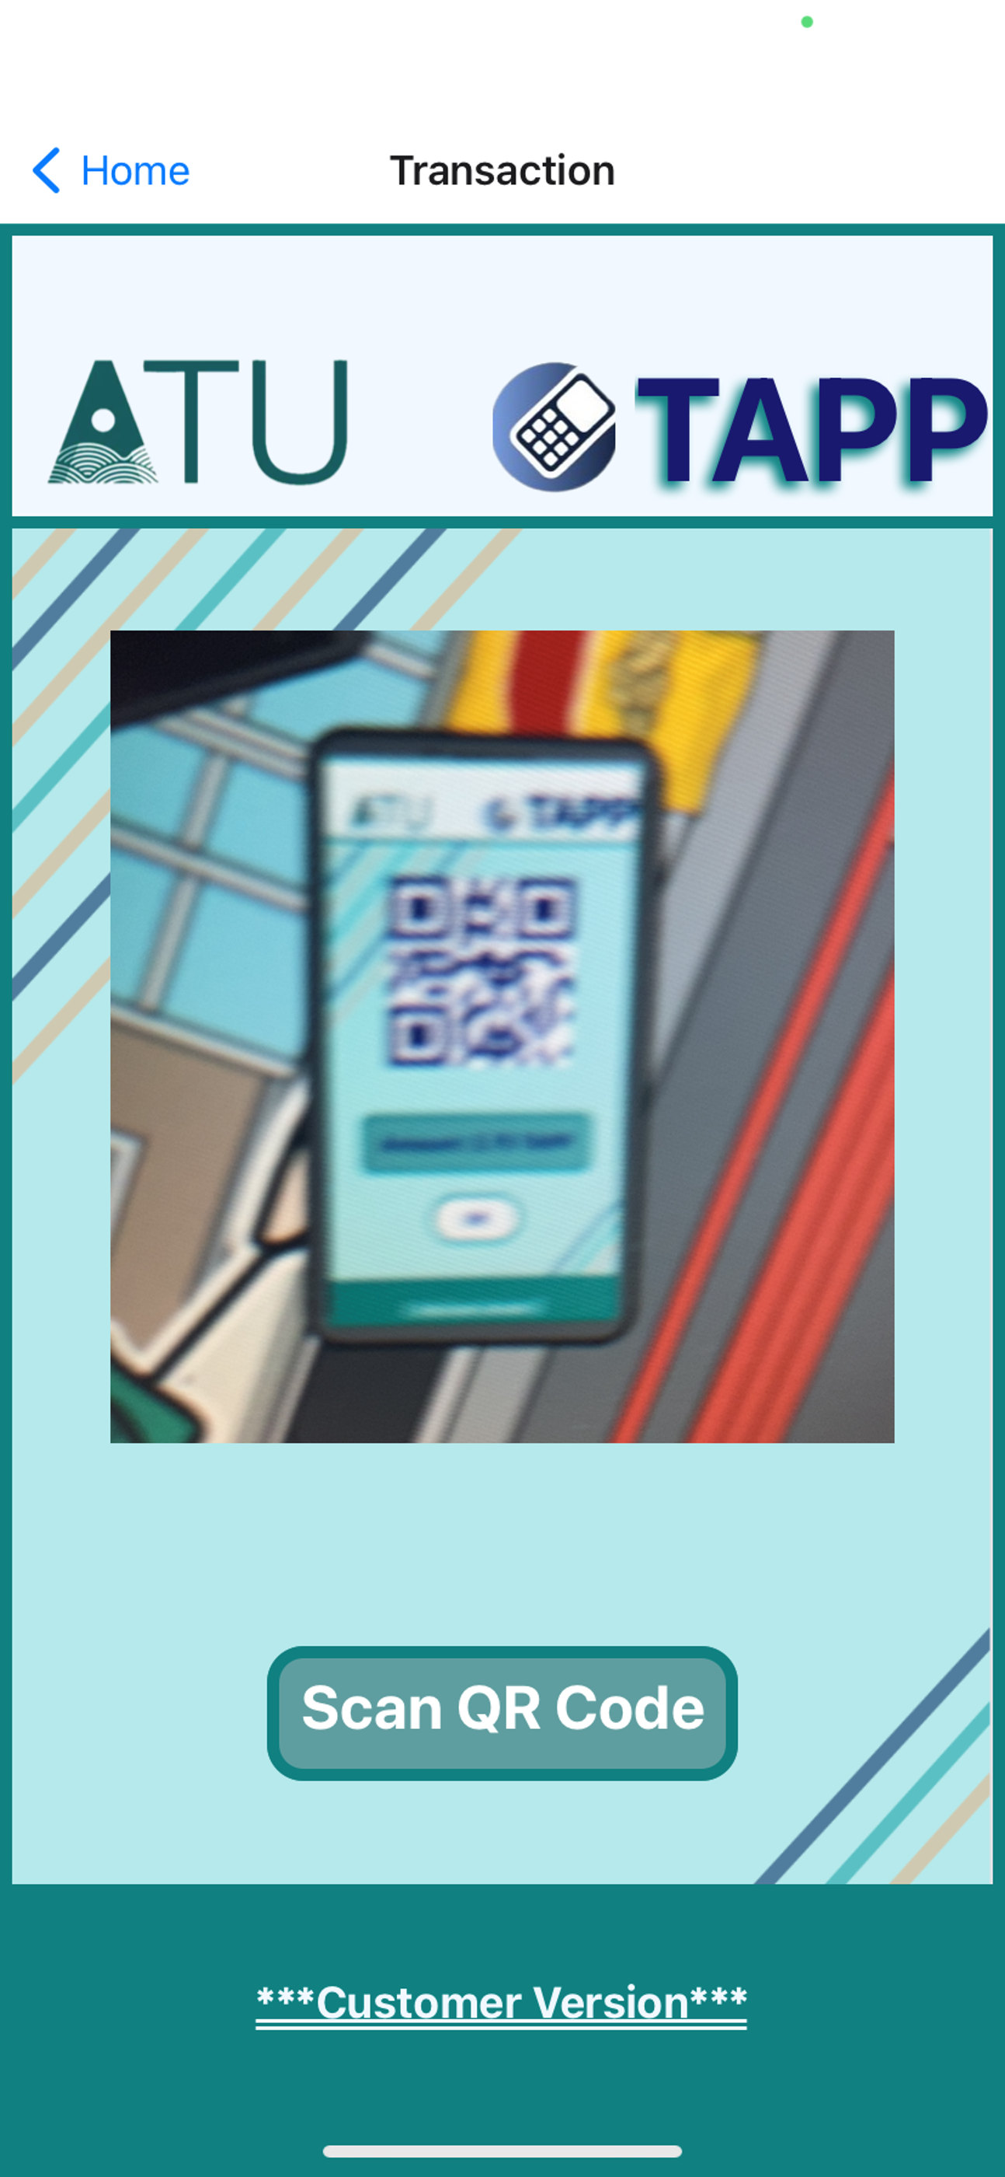
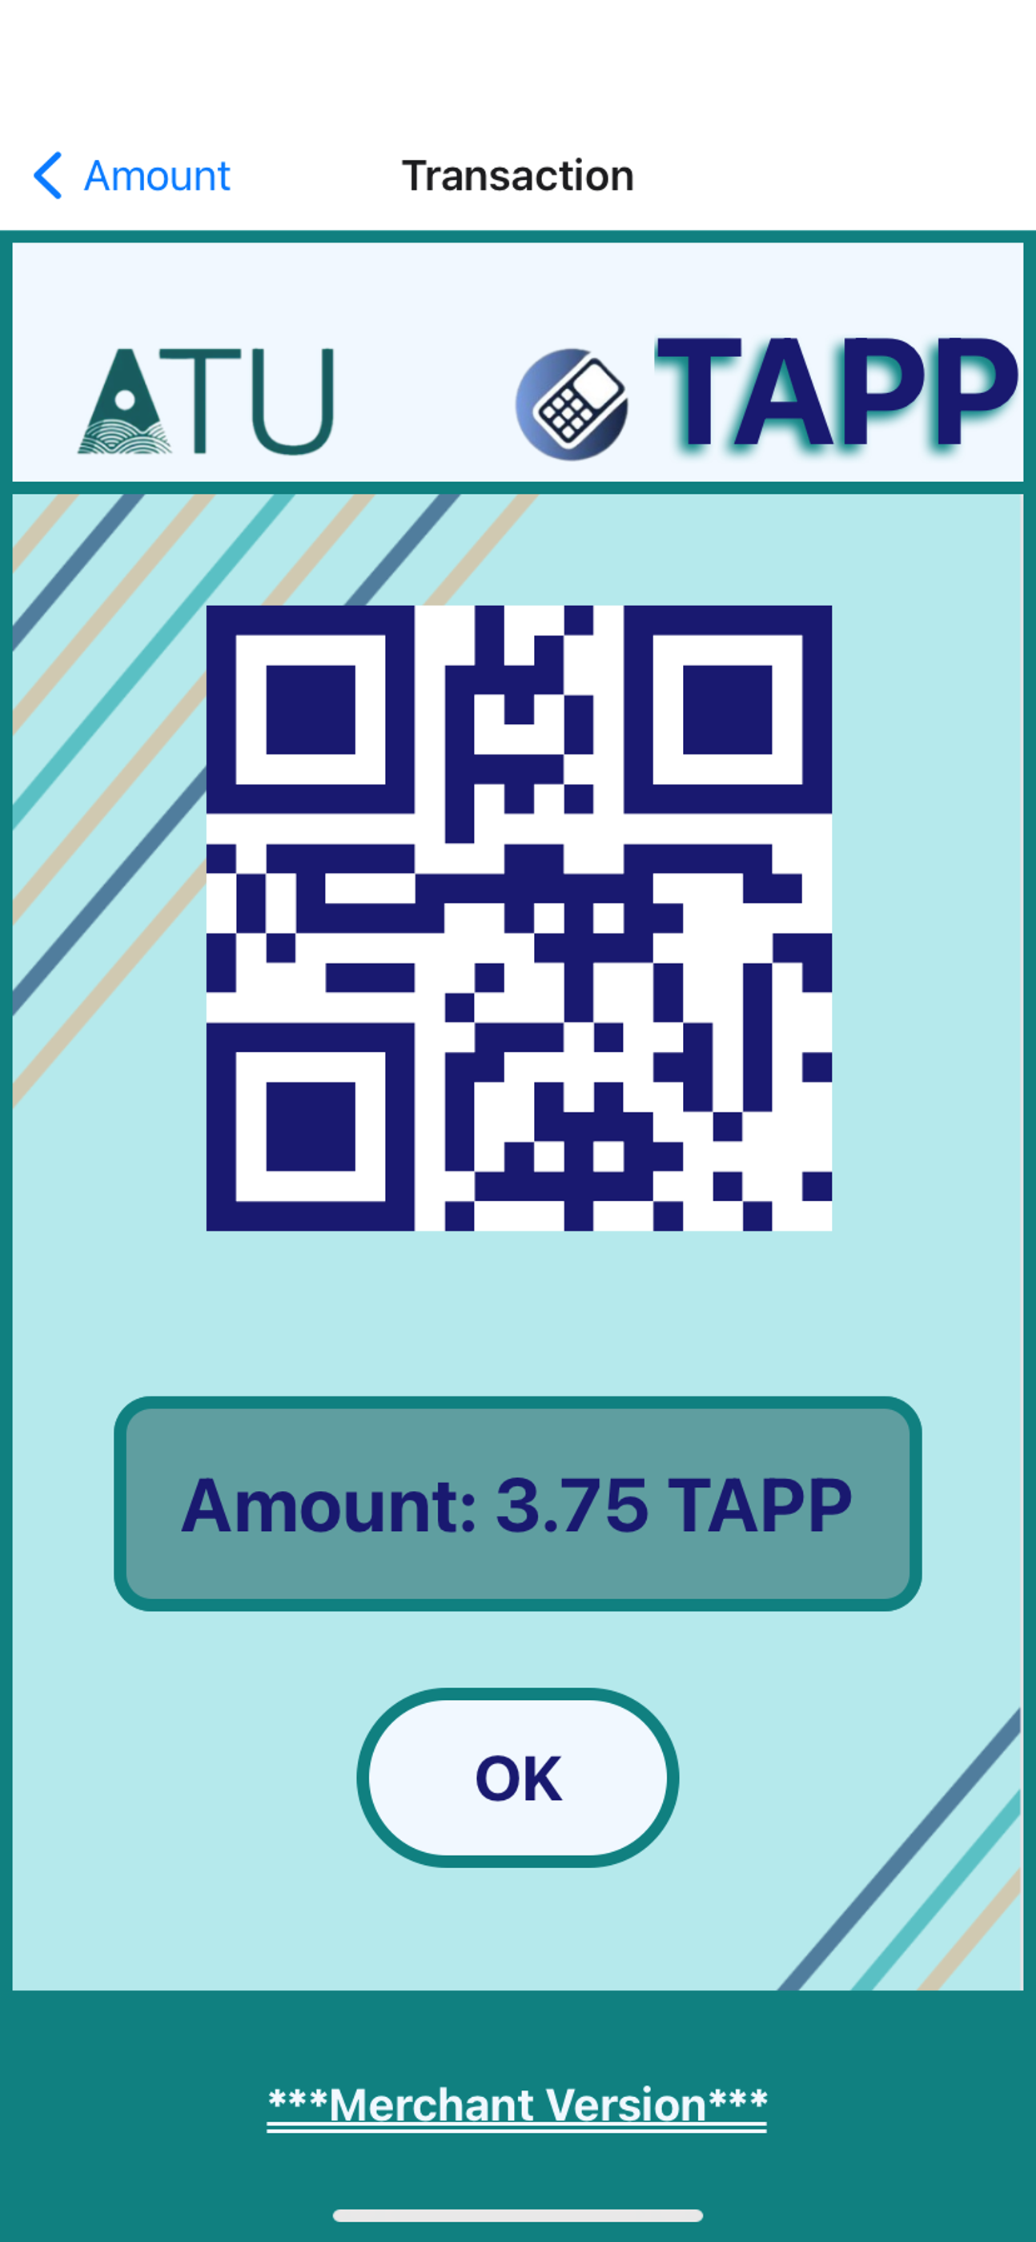
STORY BOARD

Slide 5
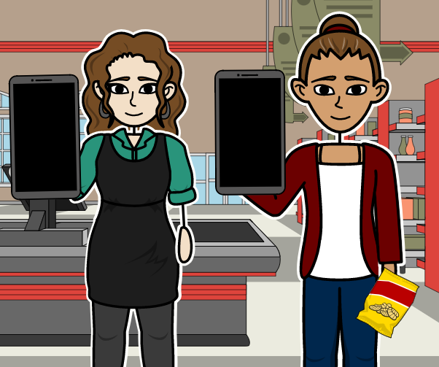
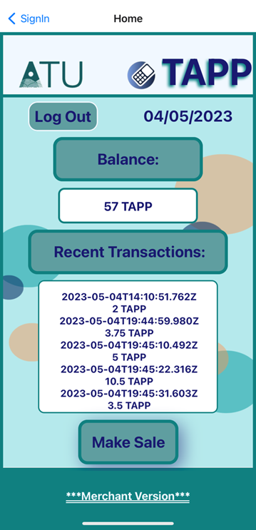
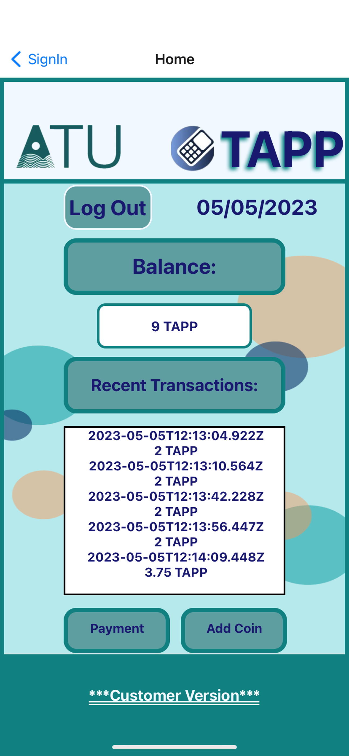
STORY BOARD

Slide 6












TECHNOLOGIES
Front End:
Back End:
Token Creation:

Slide 7
RESEARCH
Creating TAPP Token using Ethereum Blockchain
Software vs Hardware
React Native for app development

Slide 8
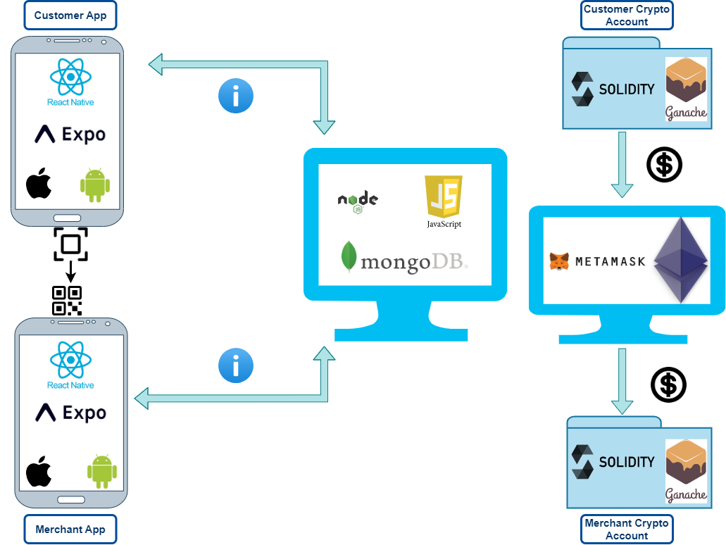
ARCHITECTURE DIAGRAM

Slide 9


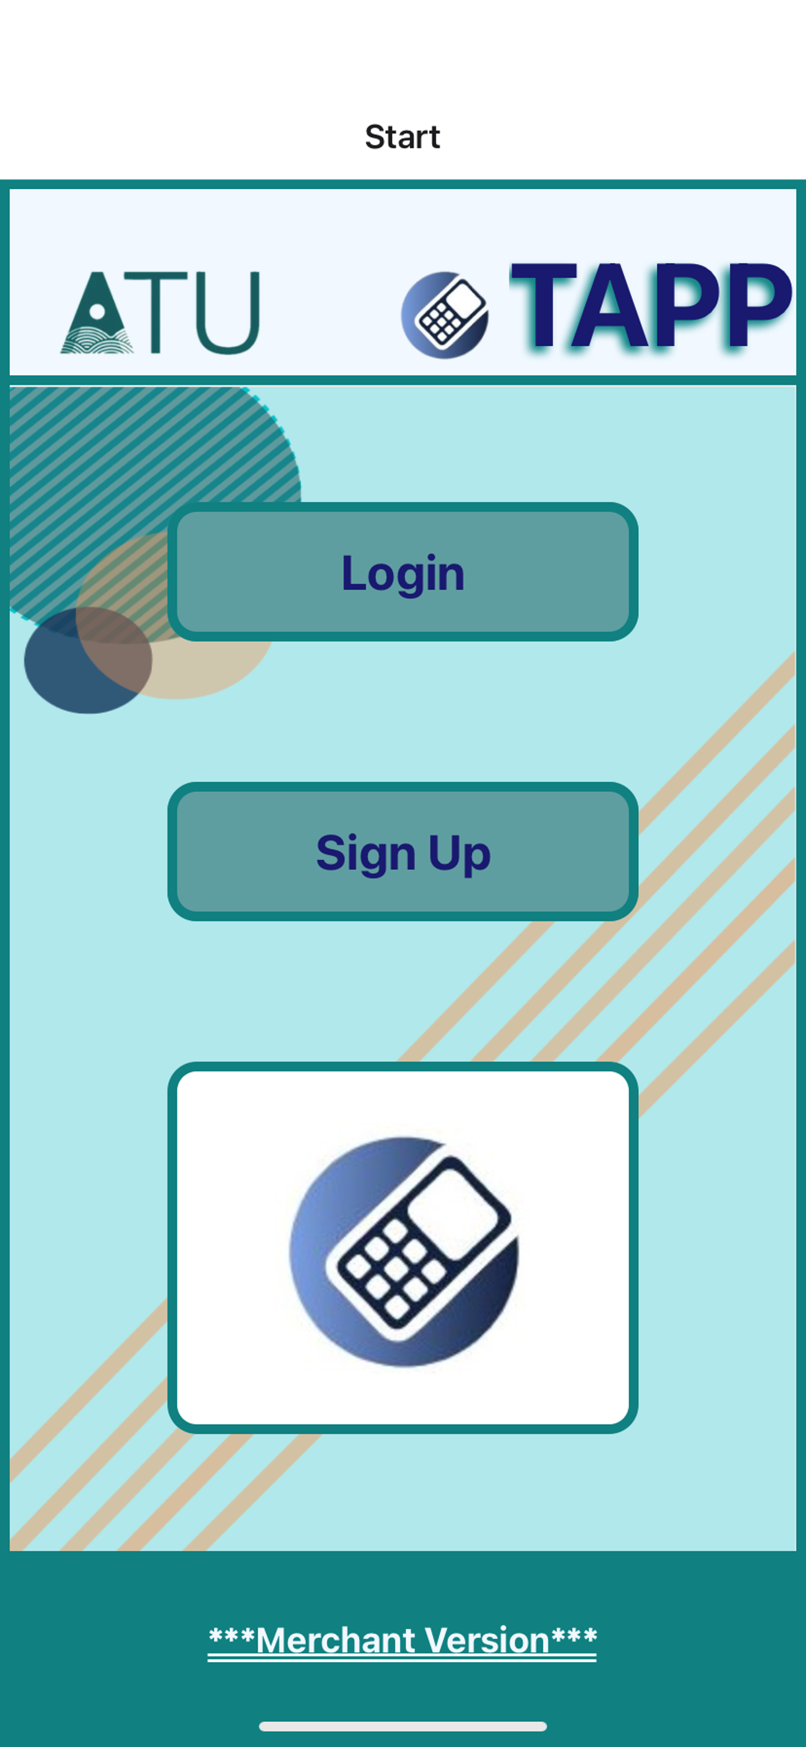
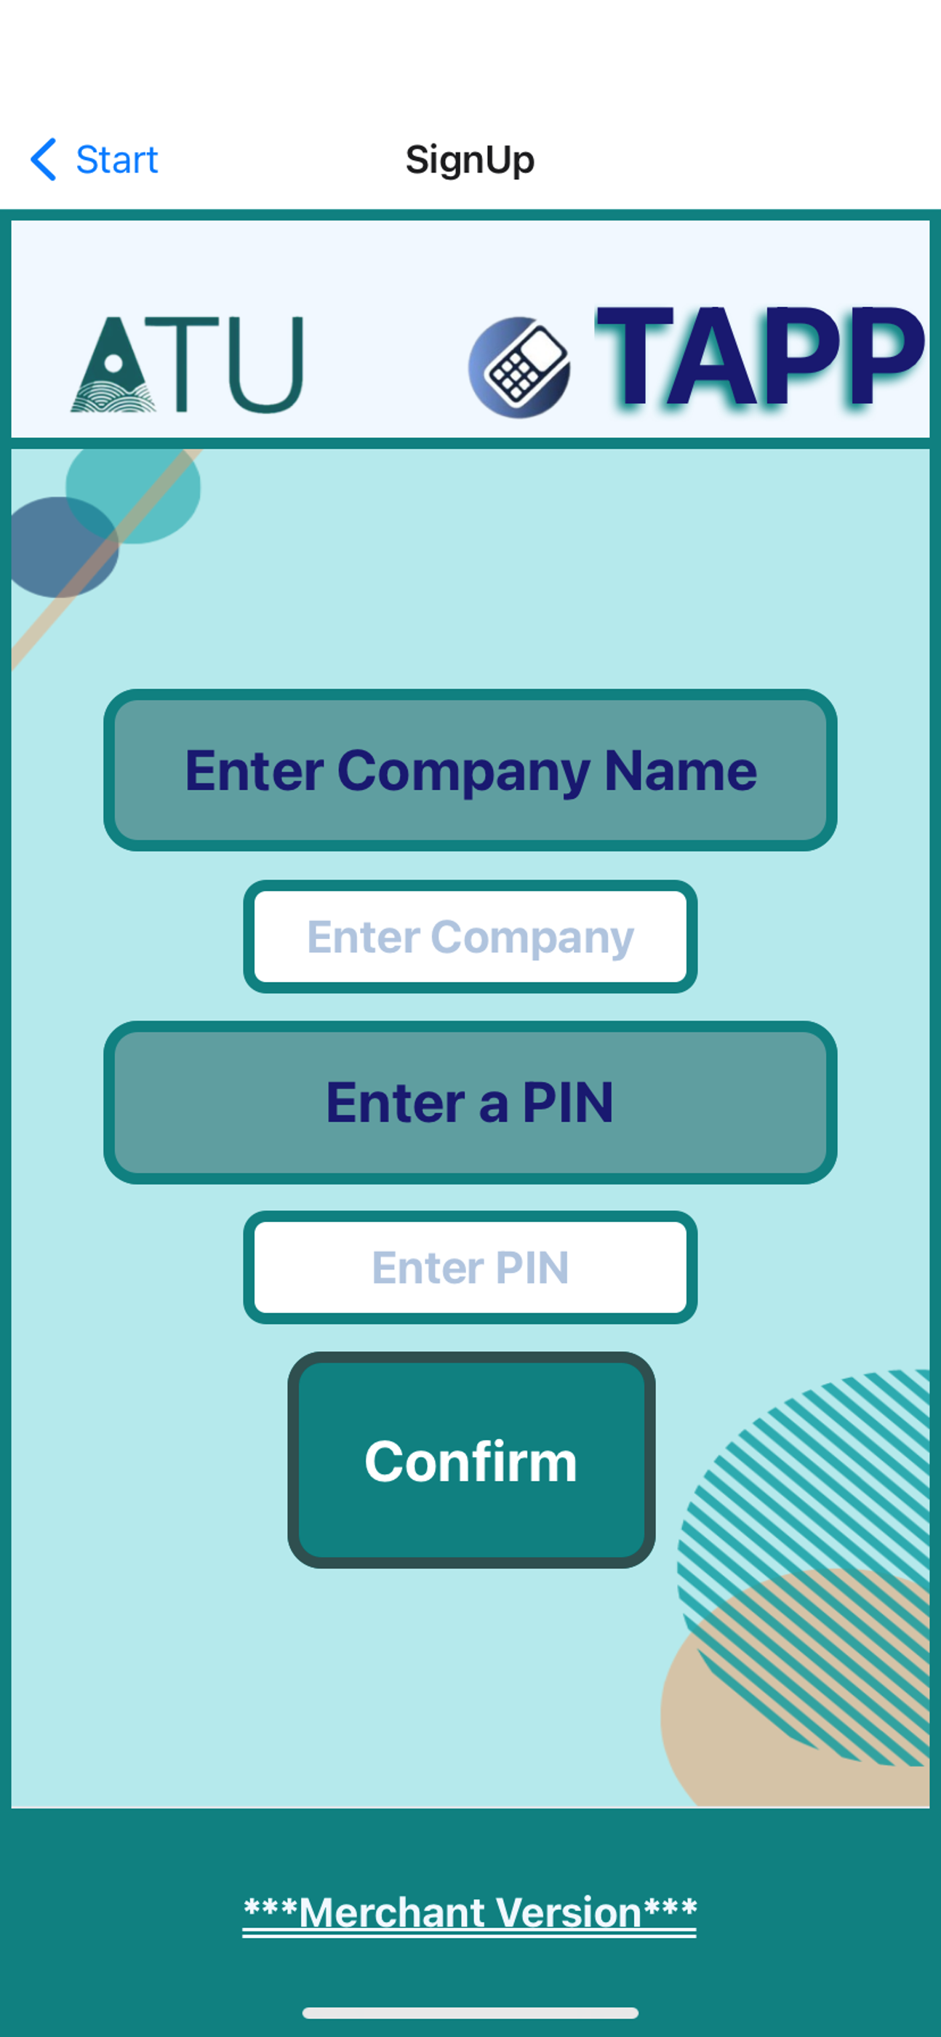
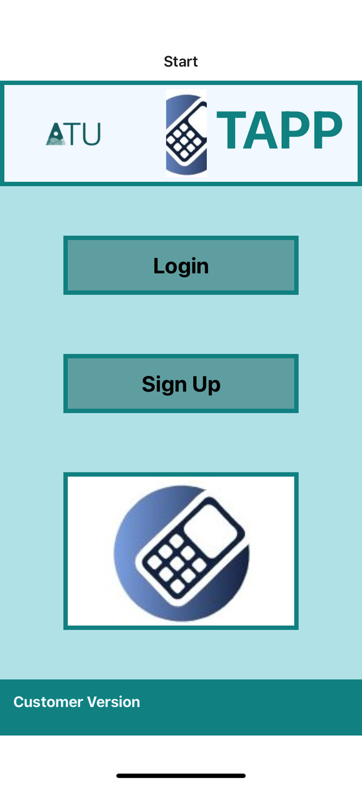
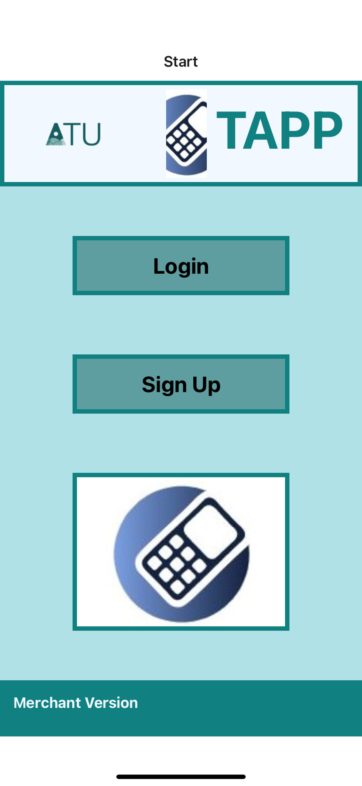


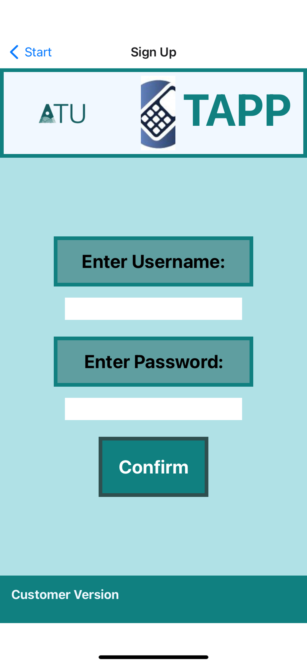

PROJECT
Merchant
Customer

Slide 10
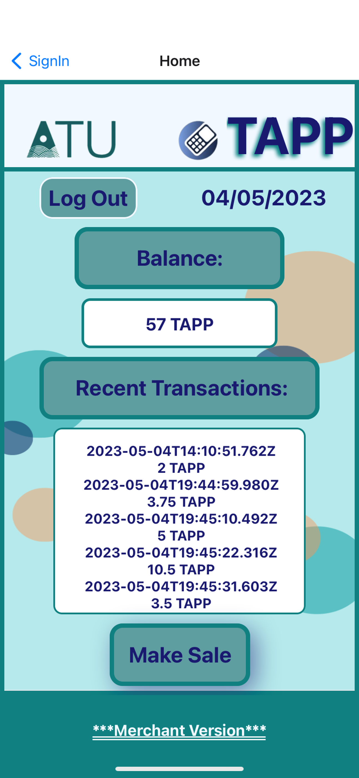
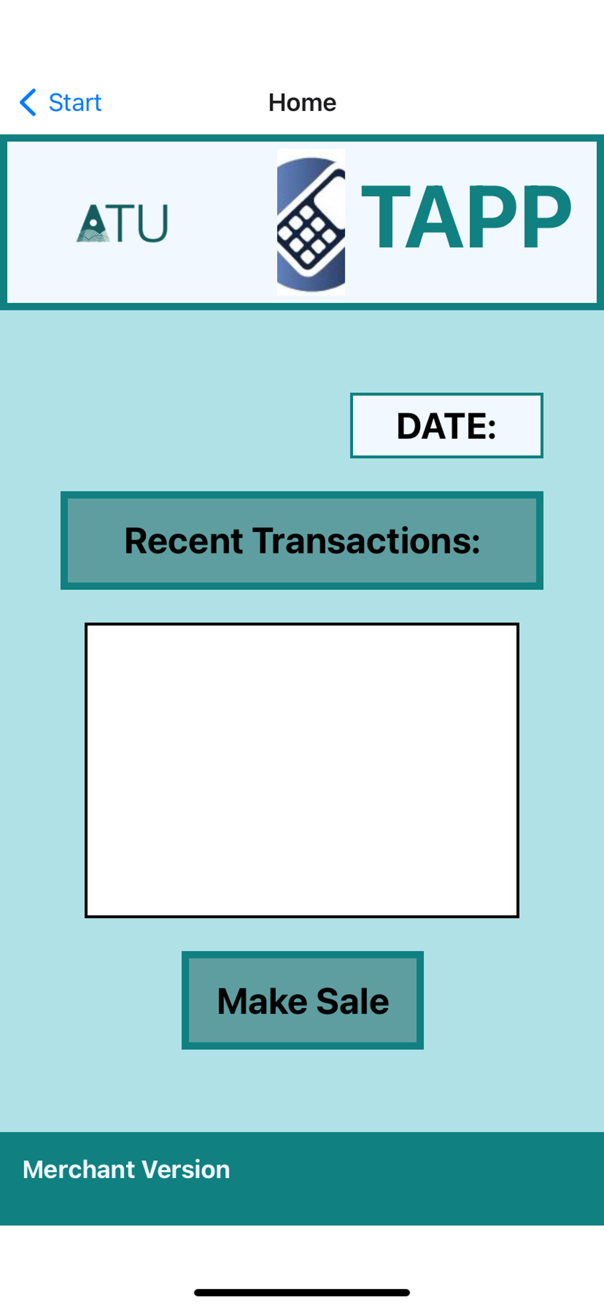
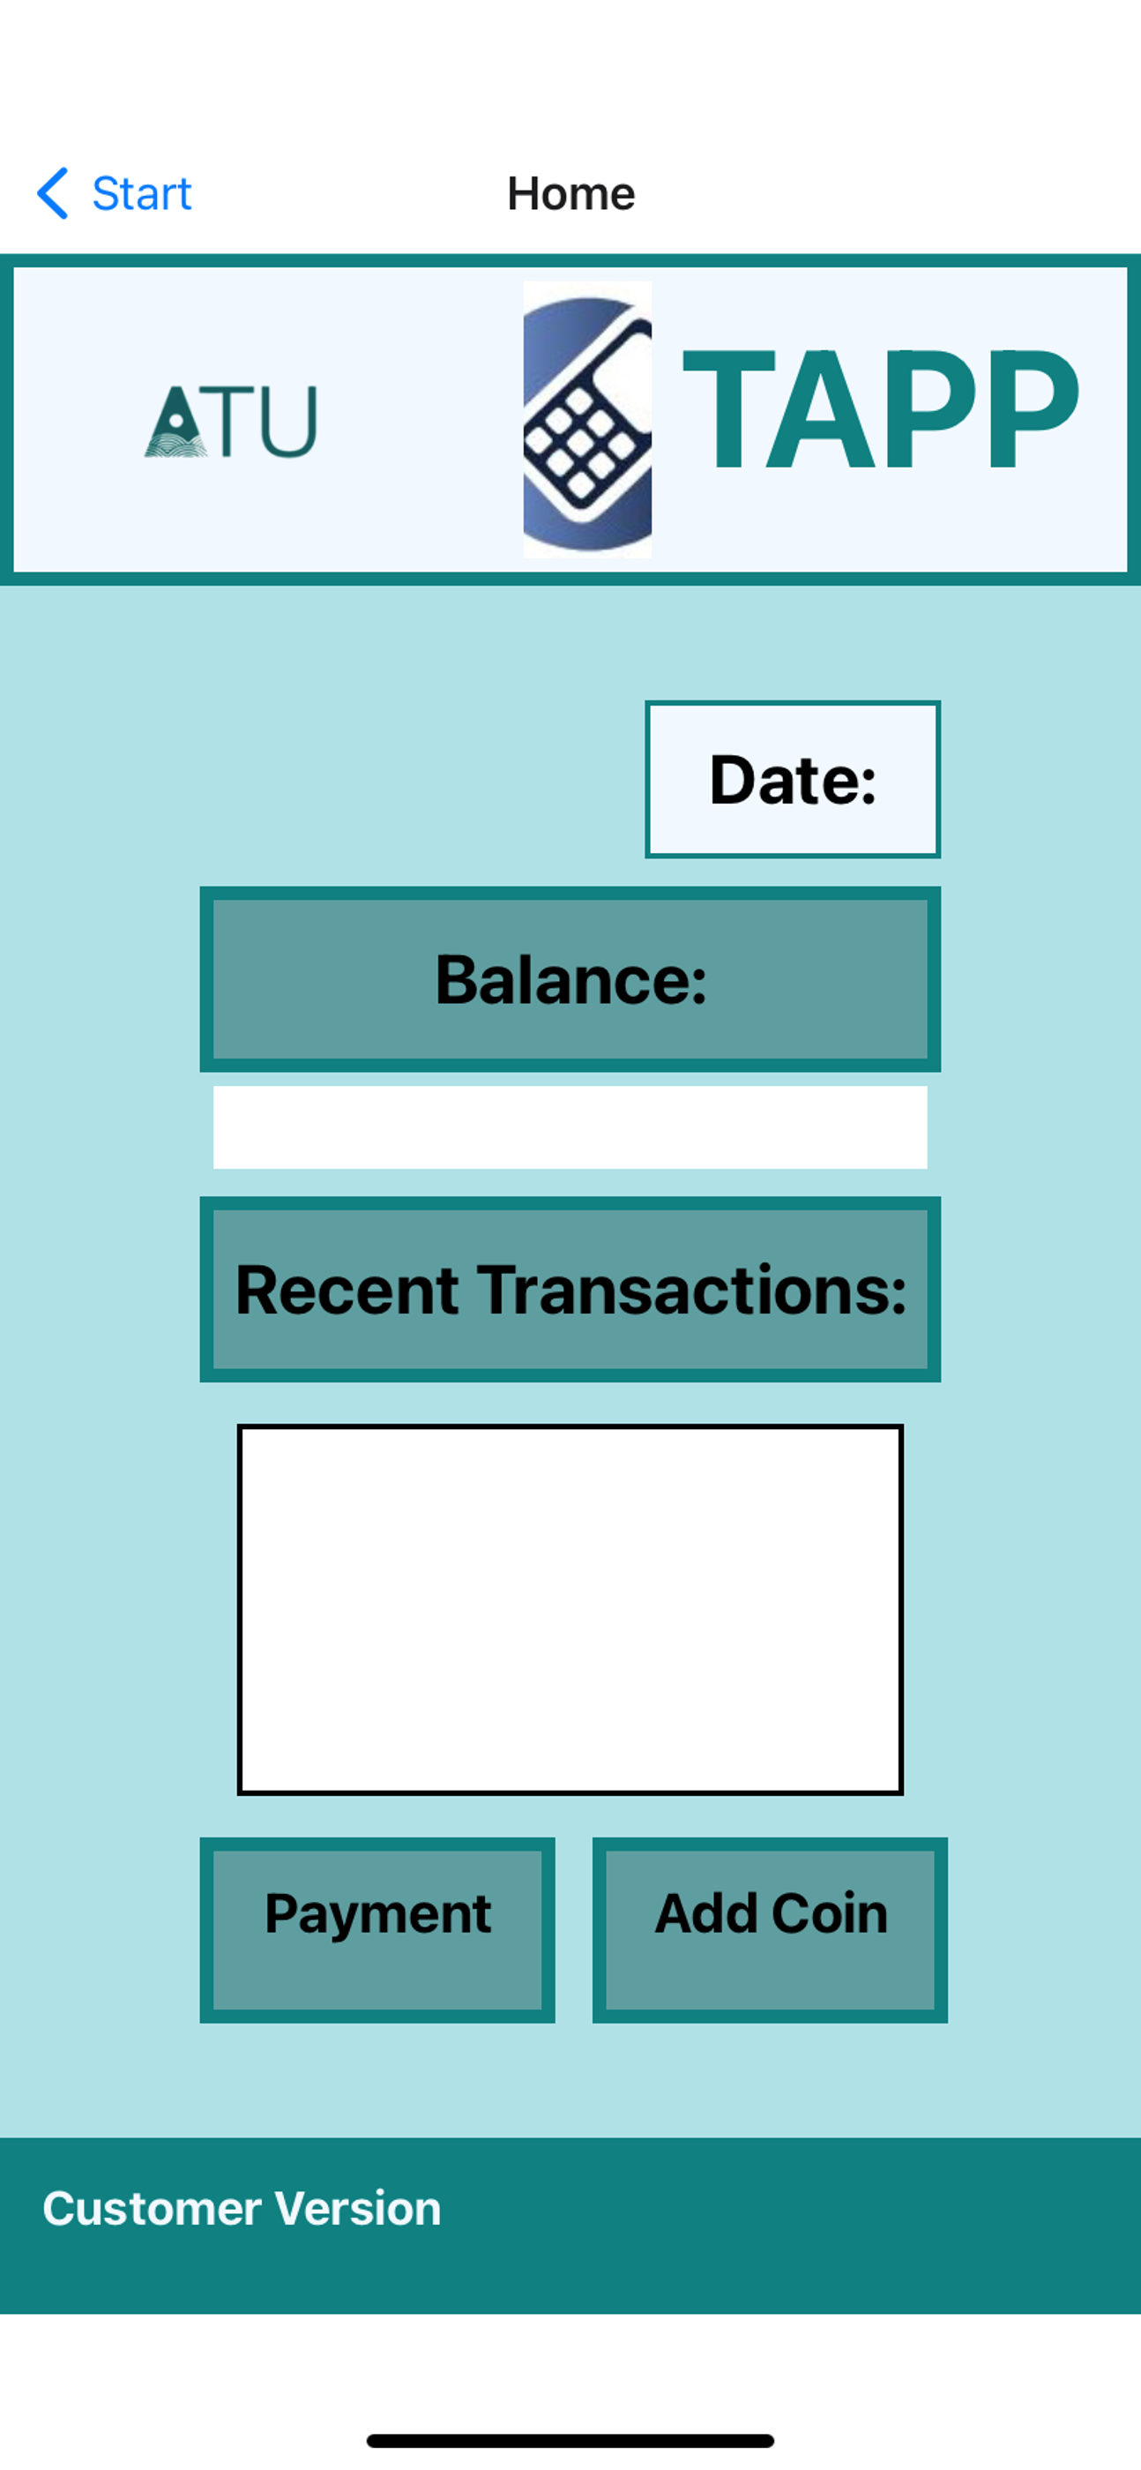
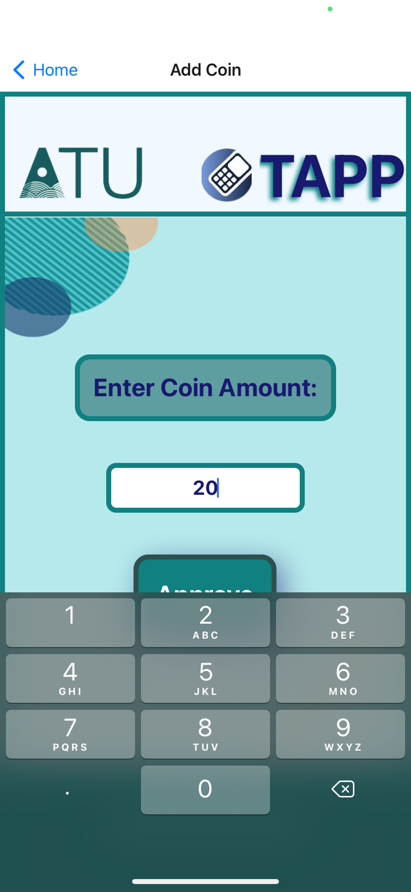
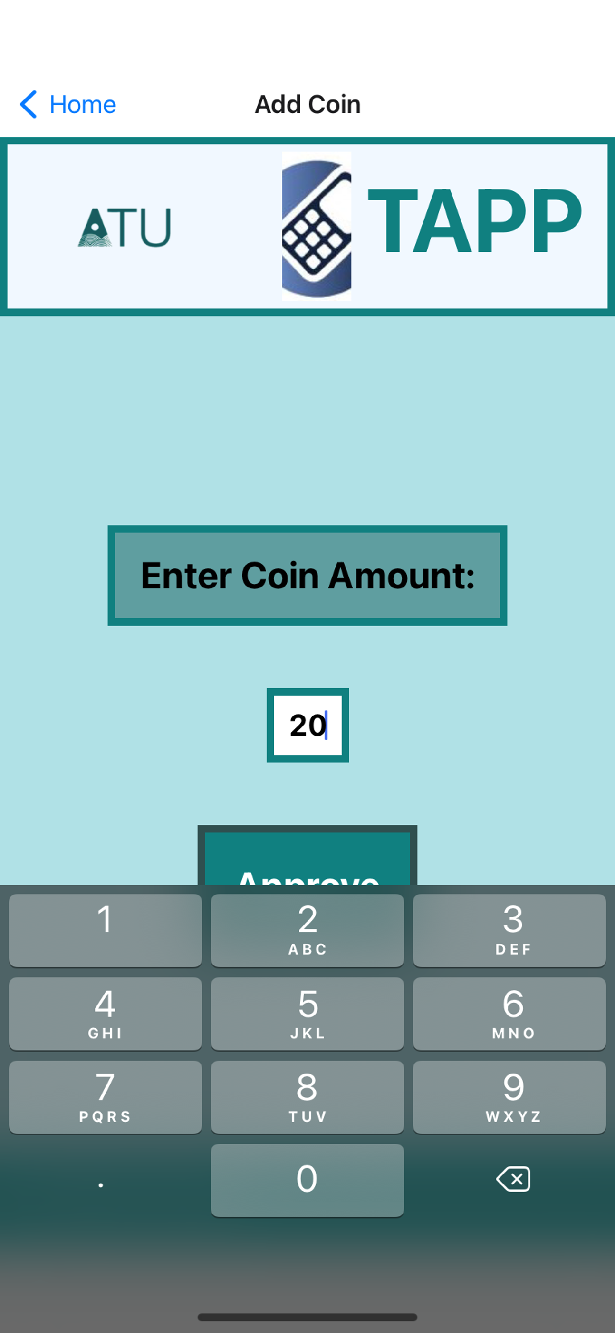

PROJECT
Merchant
Customer

Slide 11
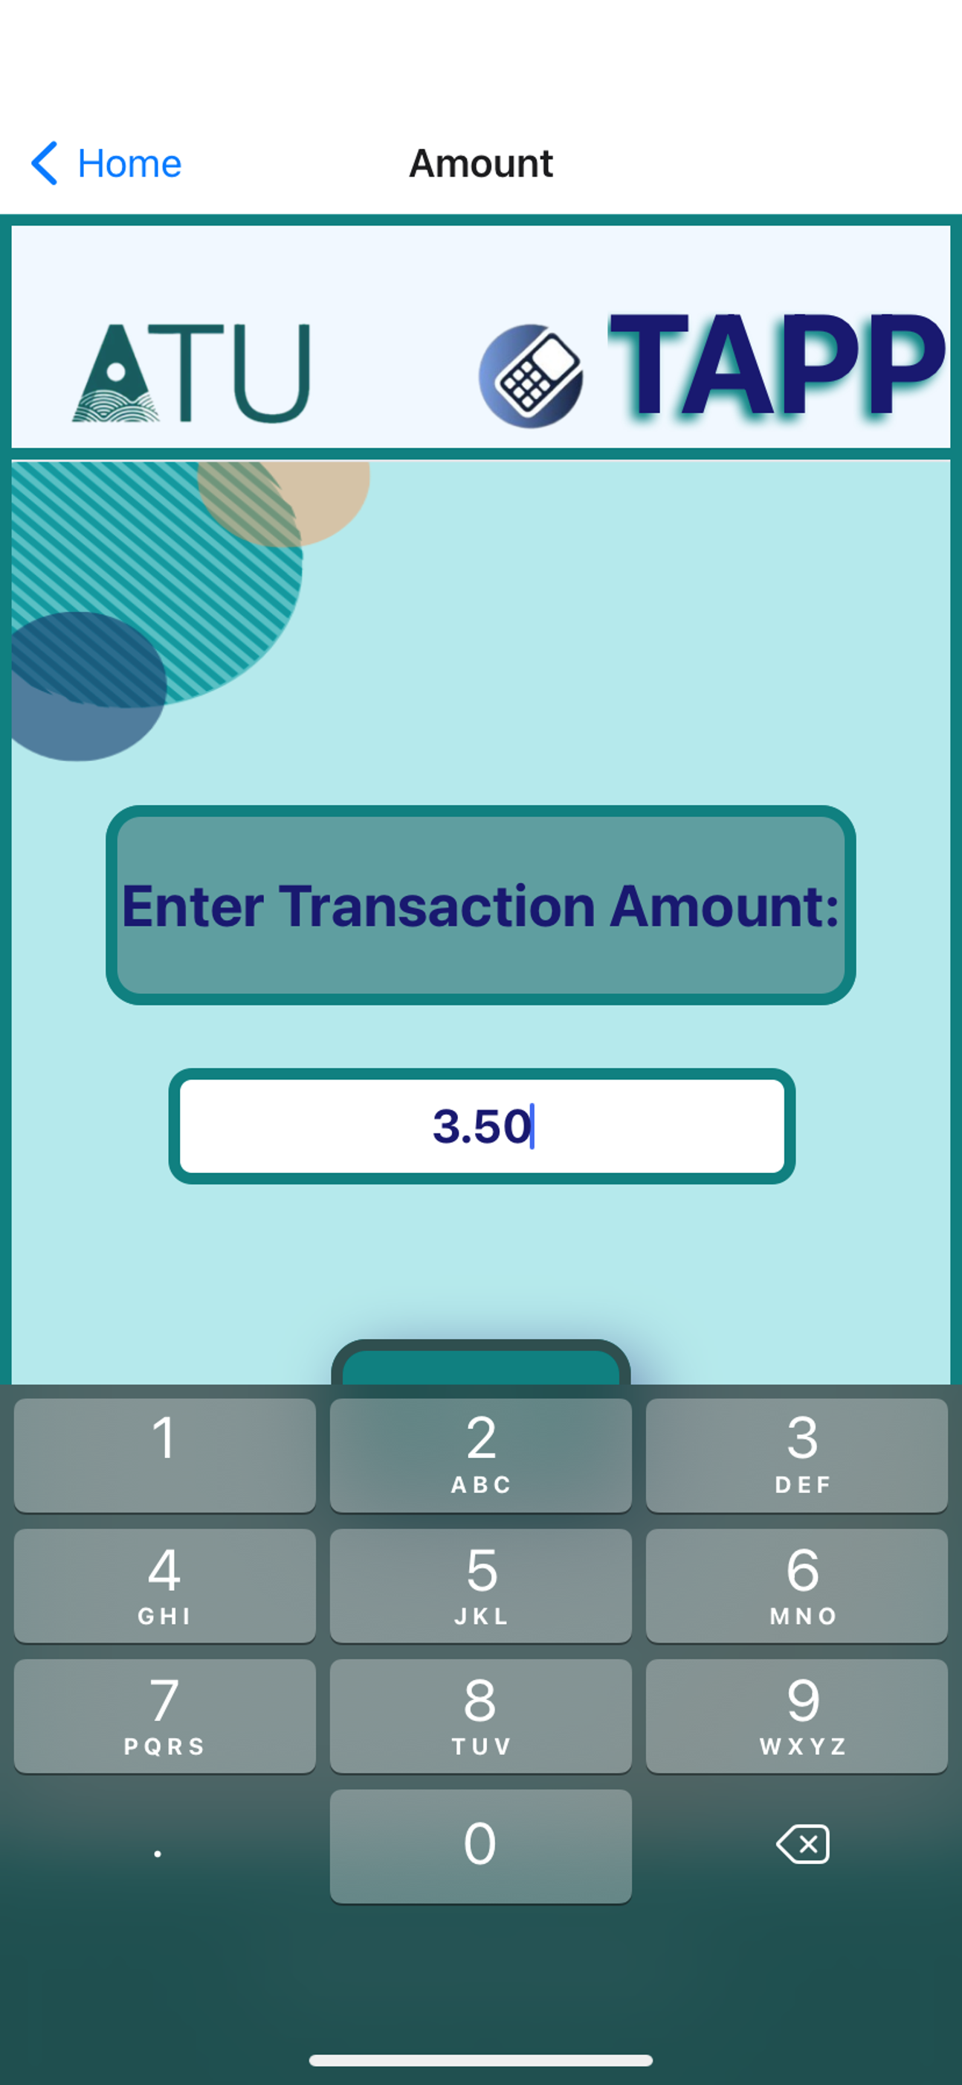

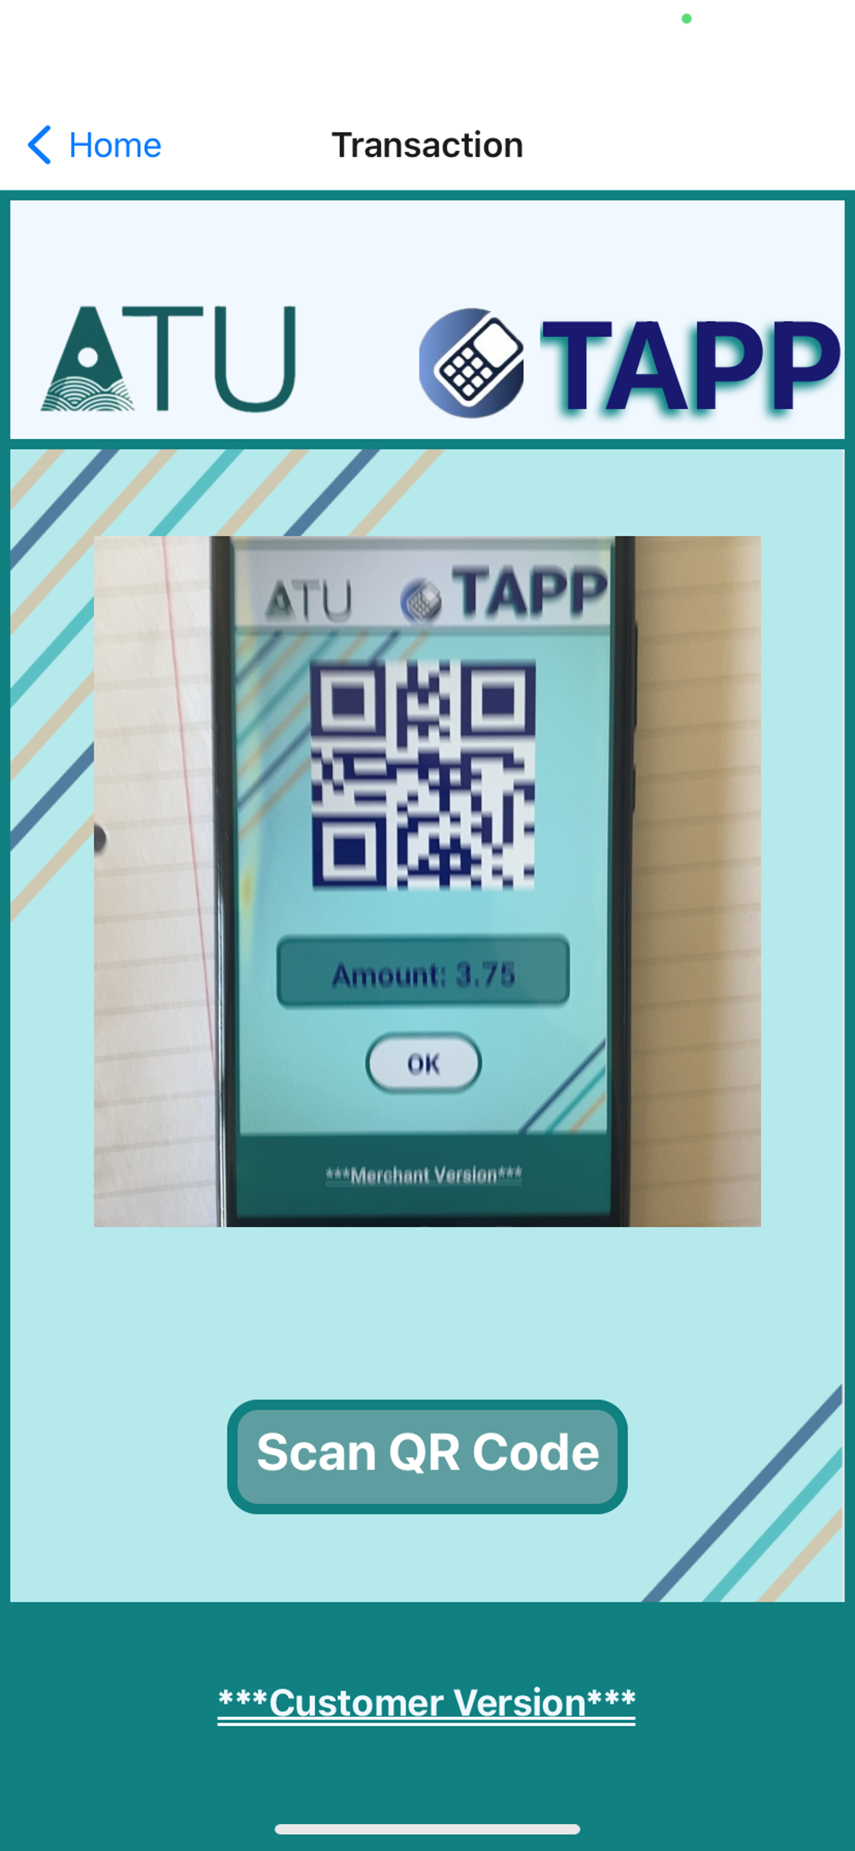
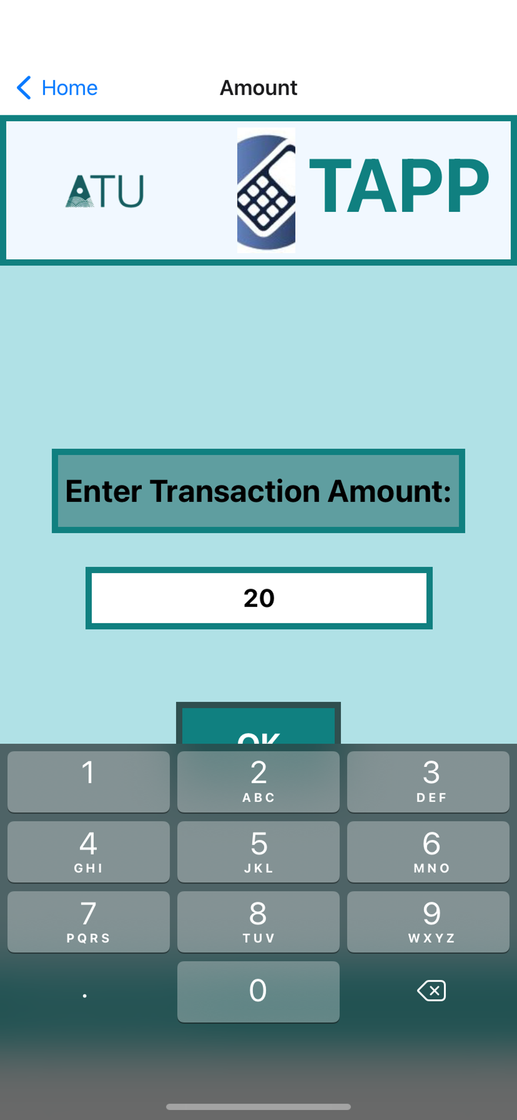
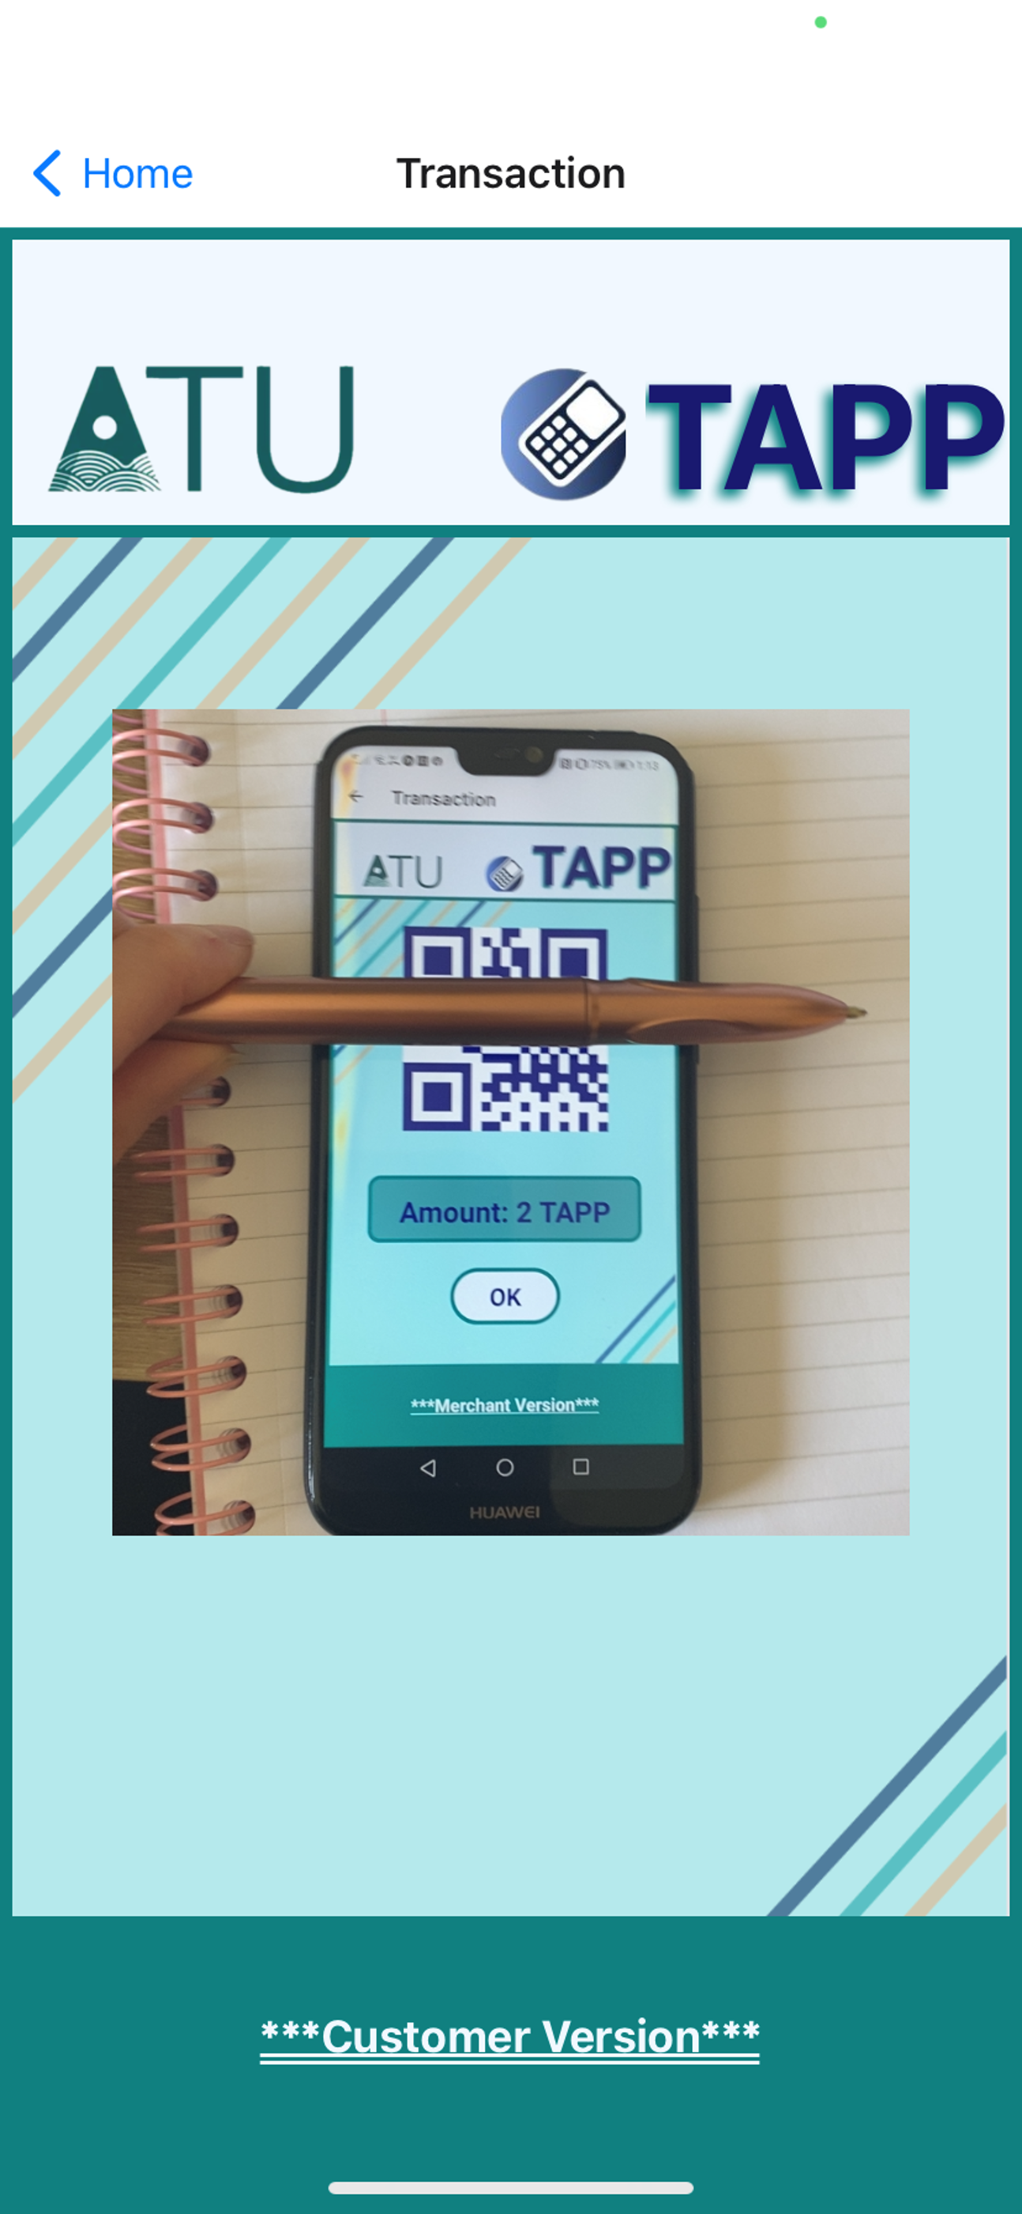
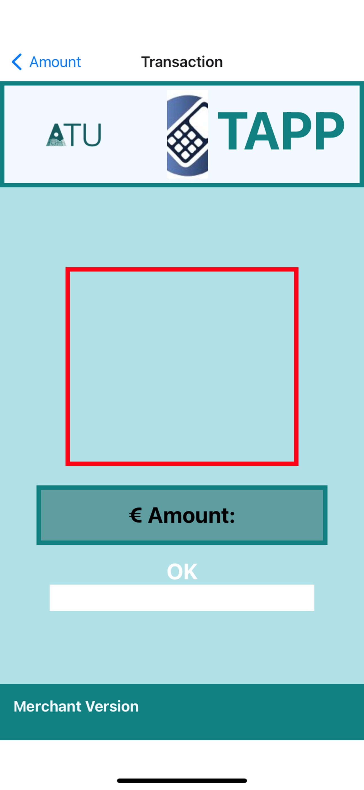
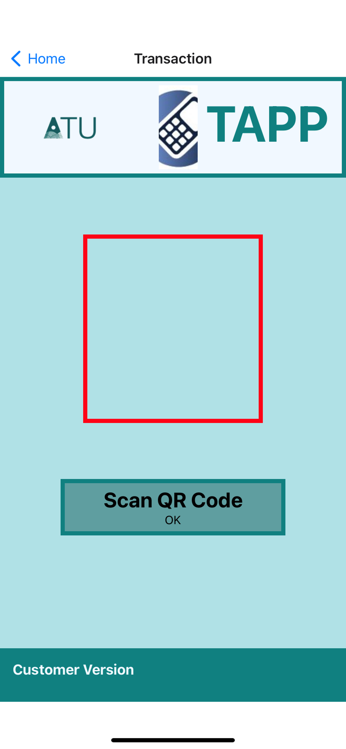


PROJECT
Merchant
Customer

Slide 12
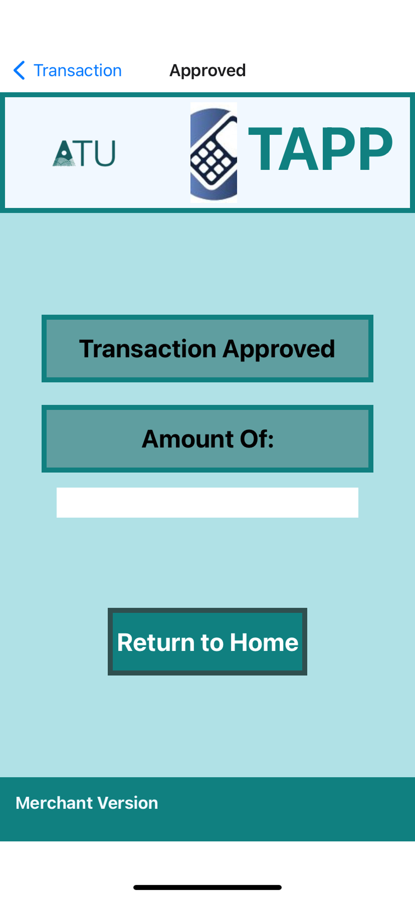
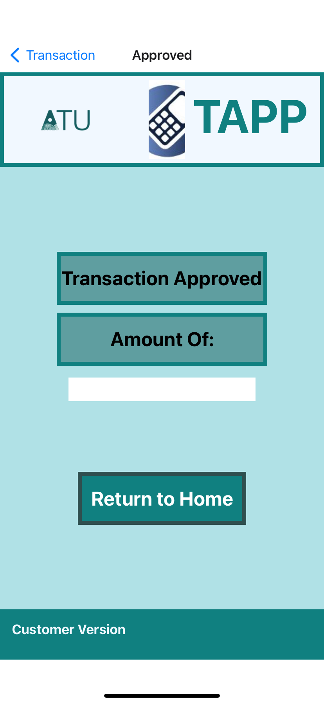
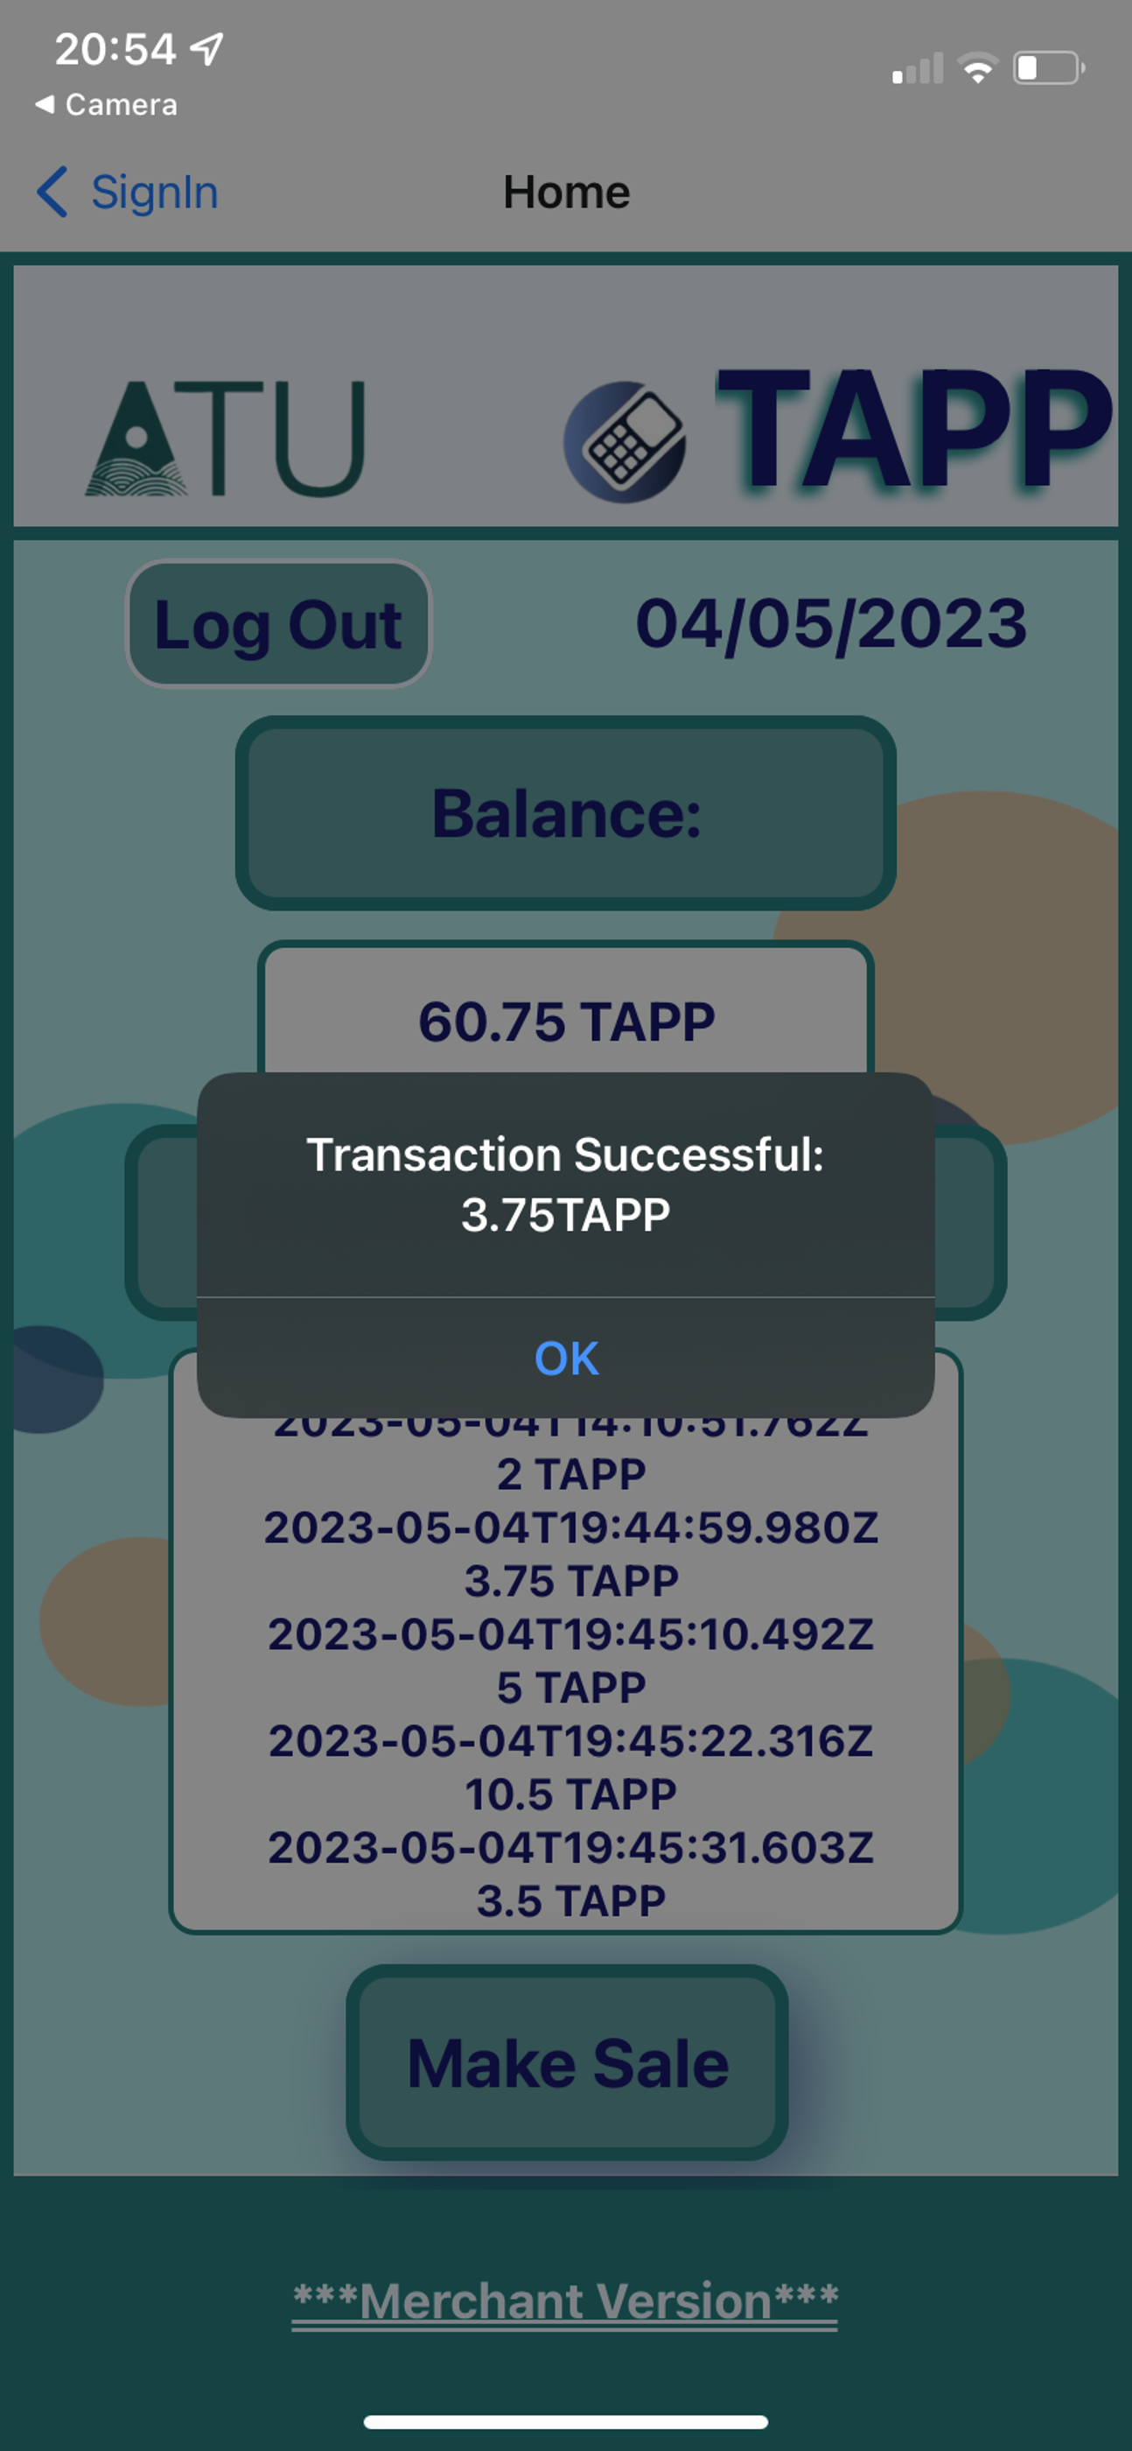
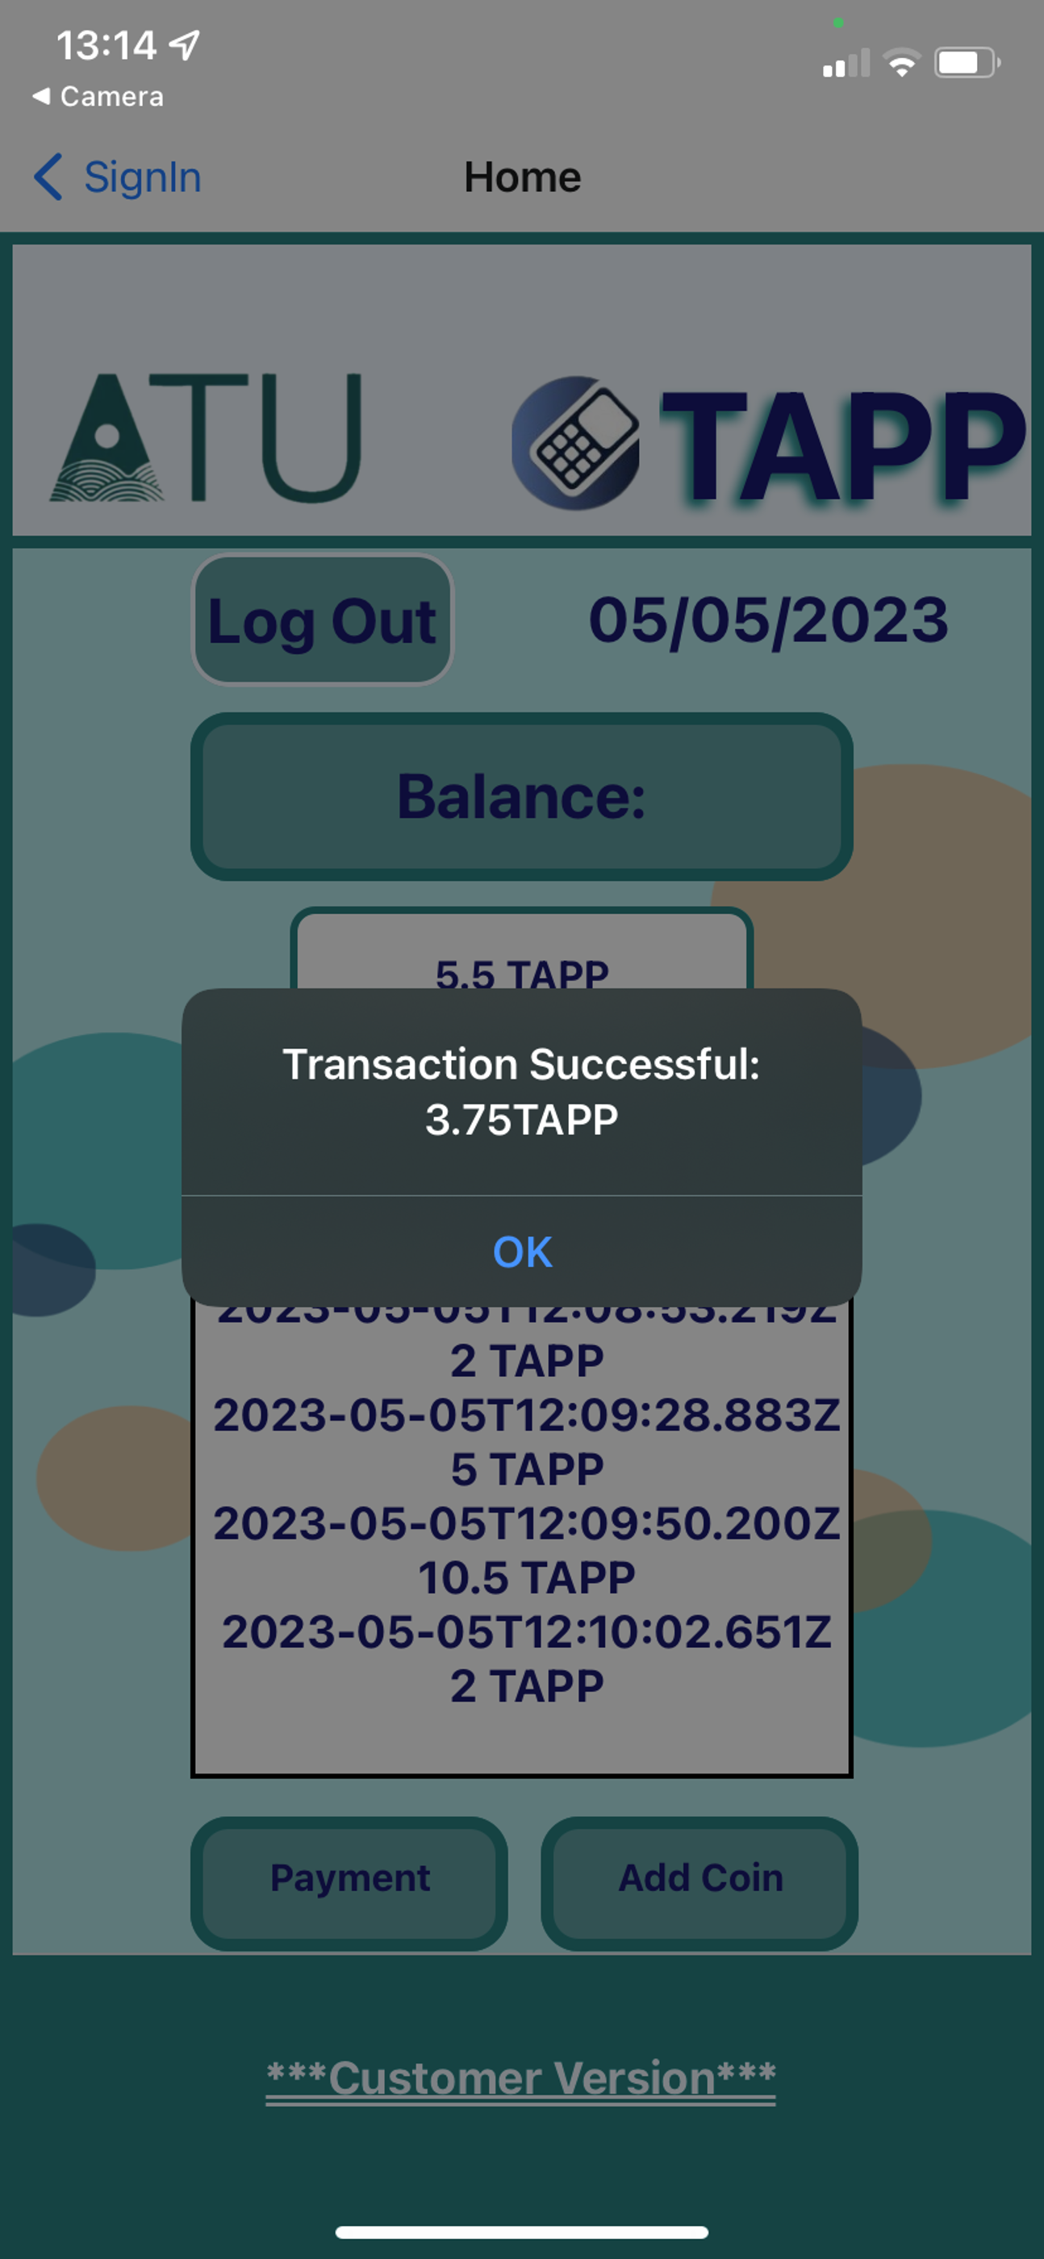

PROJECT
Merchant
Customer

Slide 13





CHALLENGES
User Input
Node.js Webserver
Learning about Solidity & Token Creation
Time Management

Slide 14
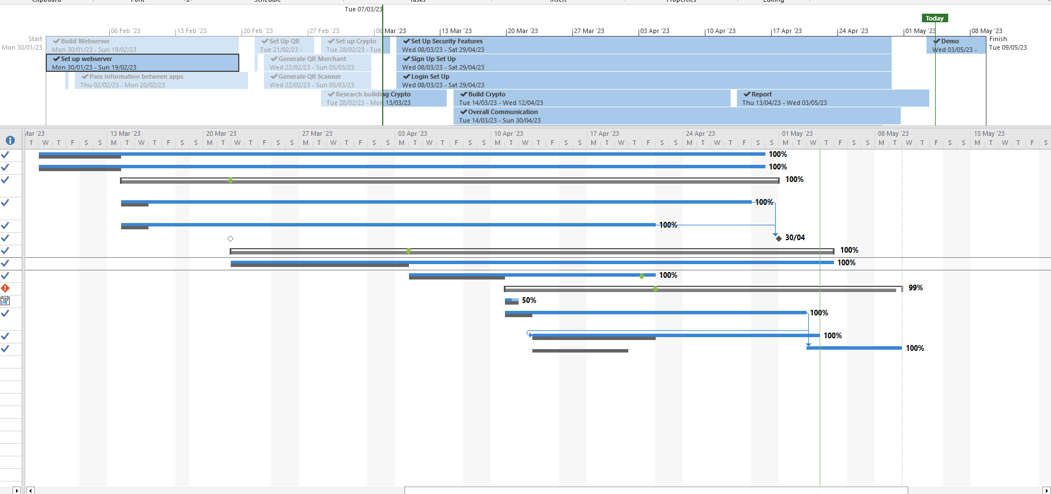


Project Management

Slide 15
FUTURE DEVELOPMENTS
Protecting the Routes
Integrate TAPP app with TAPP token code
Create Token Wallet APP to purchase TAPP tokens

Slide 16





THANK YOU
ANY QUESTIONS?

Slide 17
VIDEO DEMO
Will add demo on Tuesday for presentation

